Slide 1
Music Tuner
A research by :
Mahmoud aslan – Majd zein al-abedien – alaa al-zeir
Supervisor :
eng. Faten khalel.

Slide 2
outlines
Introduction to music tunes and it’s frequencies.
Why we need a tuner.
Problem description and simple solution steps.
FFT concept.
How does it work and Code review.
GUI implementation.
References.

Slide 3
introduction
Music scales consist of 7 different notes as described :
A number from 0 to 8 is added to these notations to identify the octave which the note belongs to. Eg : A5, C6, F3…
Do | Re | Mi | Fa | Sol | La | Si
C | D | E | F | G | A | B

Slide 4
Introduction
Each note has it’s own frequency.
Note | Frequency (Hz)
C0 | 16.3516
C#0 | 17.3239
… | …
A1 | 55.0000
Bb1 | 58.2705
B1 | 61.7354
C2 | 65.4064
Note | Frequency (Hz)
C3 | 130.813
C#3 | 138.591
… | …
A4 | 440.000
Bb4 | 466.164
B4 | 493.883
C5 | 523.251
Note | Frequency (Hz)
C6 | 1046.50
C#6 | 1108.73
… | …
A7 | 3520.00
Bb7 | 3729.31
B7 | 3951.07
C8 | 4186.01

Slide 5
Why we need a tuner ?
Most music instruments get affected by the weather and it’s strings get out of tune. So, two or more instruments can’t play together .
In order to tune these instruments we need either a very good musical ear or just use a tuner if you’re a beginner.

Slide 6
Problem Description
Our aim is to make a music tuner in MATLAB using FFT and basic sound recording.

Slide 7
Simple steps
Initialize sampling variables.
Record the audio.
Apply FFT on the recorded audio.
Extract the required frequency.
Compare the extracted frequency with standard note frequencies.
Print the result.

Slide 8
Before we start let’s talk about FFT
FFT : Fast Fourier Transform
(Fast computational algorithm for Discrete Fourier Transform (DFT) )
Fourier analysis converts a signal from its original domain (often time or space) to a representation in the frequency domain and vice versa.

Slide 9
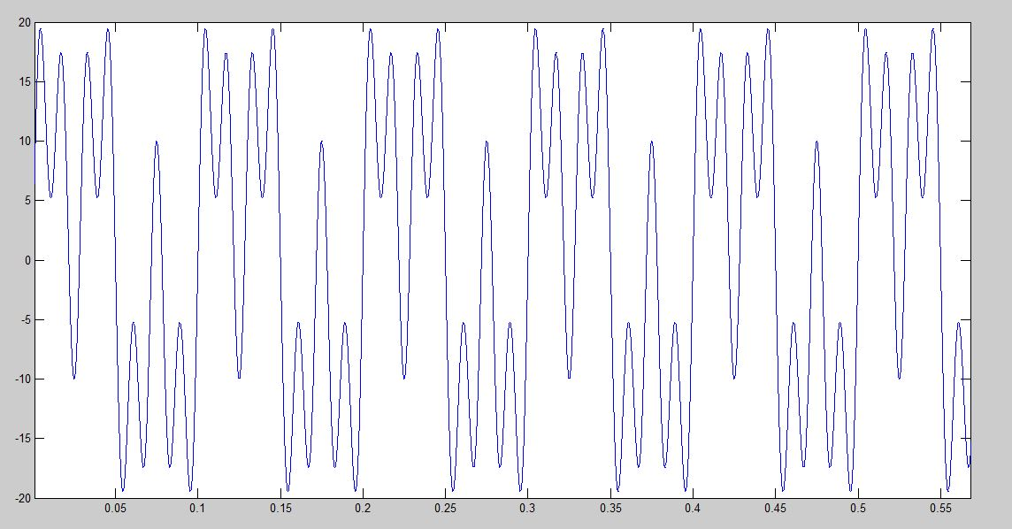
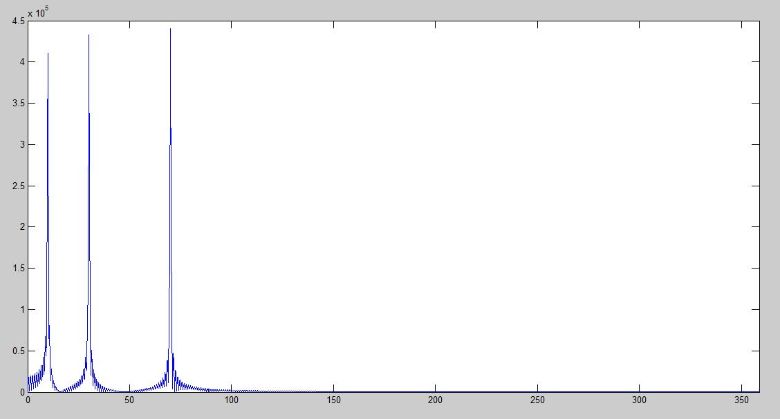
Before we start let’s talk about FFT
Here we have a signal consists of three components with frequencies : 10 – 30 – 70 Hz
FFT
Signal in the time domain
Signal in the frequency domain

Slide 10

How does it work ? Initialize sampling variables and Voice recording
In order to record audio we need to set some variables :
Sampling frequency (Fs): number of samples per second.
Total number of seconds: n*Fs.
We can start recording using MATLAB built-in function wavrecord :

Slide 11
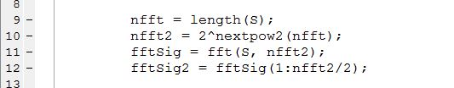
How does it work ? Applying FFt
First we calculate the length of our signal and get the next power of 2 number (to make it faster).
We apply FFT to that signal and using the calculated length
After that we take only the first half of the FFT (because it’s symmetry)

Slide 12
How does it work ? Applying FFt
To draw the x-axis as frequencies we used the following :
We used 0:nfft2/2-1 to generate an array with same length as the y-axis.

Slide 13

How does it work ? Extracting the required frequency
The values output by the FFT are complex, so they have a Re and Im part, but this can also be expressed as a magnitude and phase. For audio signals, it's usually the magnitude that's the most interesting, because this is primarily what we hear.
First we use the abs(fftSig2) to get the magnitude (which represents the y-axis).
Then we find the max value of the magnitude.
After that we find the index of that max in the array (fftSig2) in order to find the corresponding element in the array (xfft) which represent the frequency on the (x-axis).
We used MATLAB find function to get the index of the max value.

Slide 14
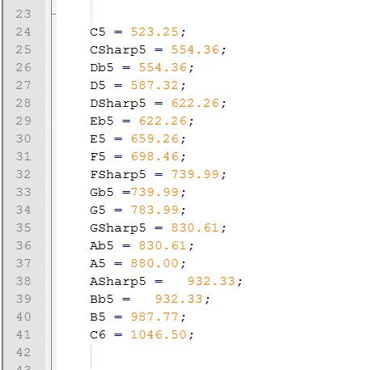
How does it work ? Comparing with standard frequencies
Now we have our frequency all what we have to do is comparing this frequency with world standard frequencies of music tunes.
Here we defined the frequencies variables

Slide 15
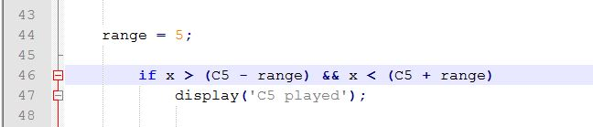
How does it work ? Comparing with standard frequencies
We made a range variable in case of some noise happened so we compare with the tune’s standard frequency ± range :

Slide 16
References
We have uploaded this project as an open source project on github :
https://github.com/mhmoodlan/MATLAB-Tuner
Links to used references :
https://en.wikipedia.org/wiki/Fast_Fourier_transform
https://en.wikipedia.org/wiki/Piano_key_frequencies
https://www.youtube.com/watch?v=HiIvbIl95lE
https://www.youtube.com/watch?v=3FAIXEkxyBs

